Slide 1
App for Work Systems Design Lab
Group - 5
GROUP MEMBERS: Konda Jnanasree
Lakshya Manan Jaiswal
Sri Sai Vaibhav
Narella Sai Kiran

Slide 2
Introducing new widgets :
MaterialPageRoute: A modal route that replaces the entire screen with a platform-adaptive transition. For android, the entrance transition for the pages slides the route upwards and fades it in. The exit transition is the same, but in reverse.

Slide 3
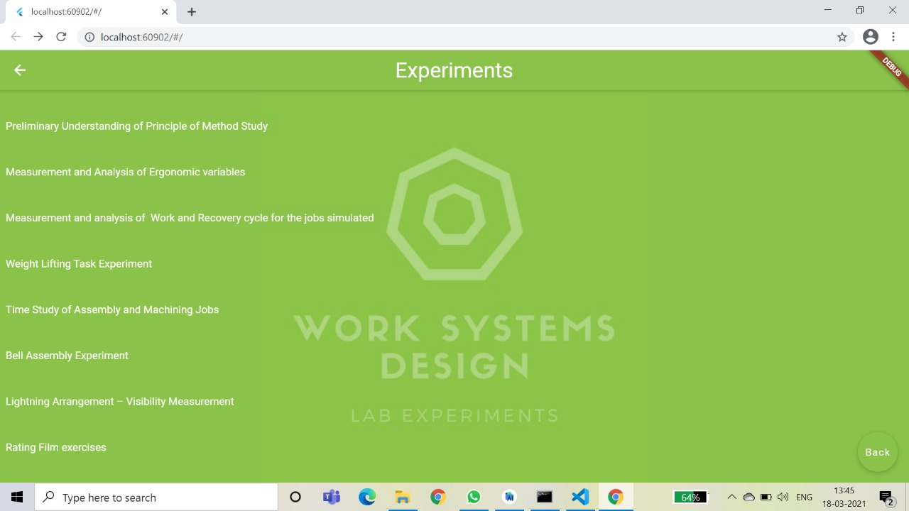
TRANSITION FROM THIS WINDOW

Slide 4
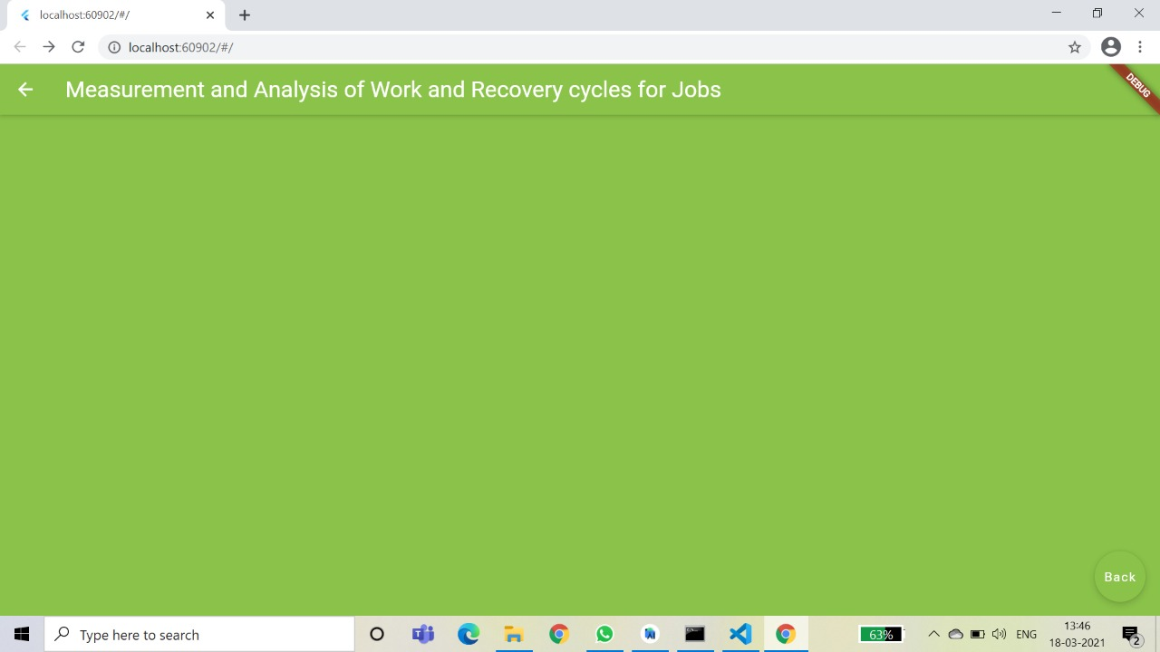
TRANSITION TO THIS WINDOW

Slide 5
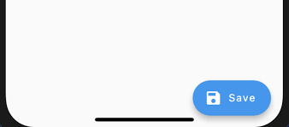
Introducing new widgets :
FloatingActionButton: A material design floating action button. A floating action button is a circular cutton that hovers over the content to promote a primary action in the application.
Floating Action Button

Slide 6
Introducing new widgets :
FlatButton: This is a material design widget in flutter. It is a text label material widget that performs an action when the button is tapped.

Slide 7
Flat Button

Slide 8
Future work plan:
Adding WSD Experiment Details: Experiment details will be added complete with their objectives, procedures, and their importance and industrial applications.
Short MCQ quiz: Each experiment will have a short pop quiz at the end which will include questions that will require the user to think critically about the experiment and will enhance their understanding
In-app videos: Each experiment will have in-app videos hosted by platforms like YouTube. These videos will be relevant to the concerned experiment and will add to the user’s understanding of the experiment.

Slide 9
Thank You

